Slide 1
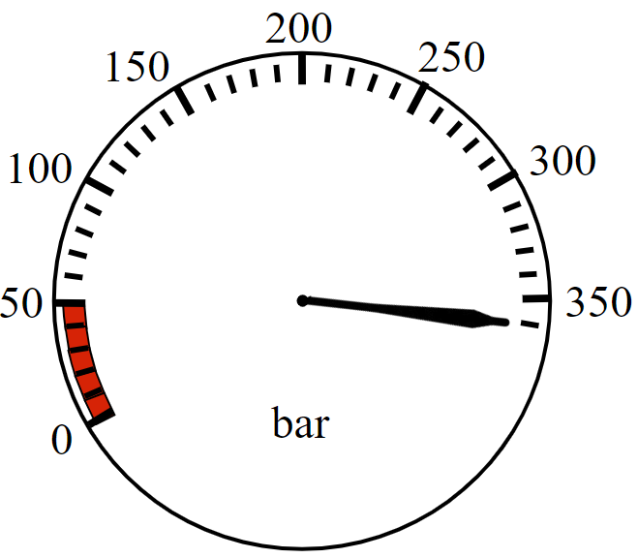
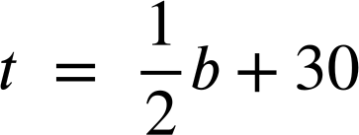

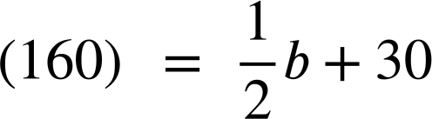
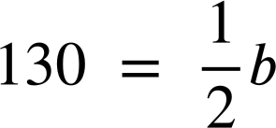
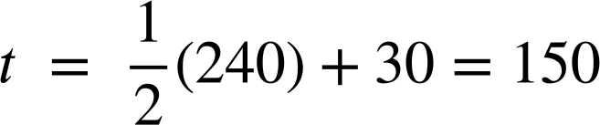
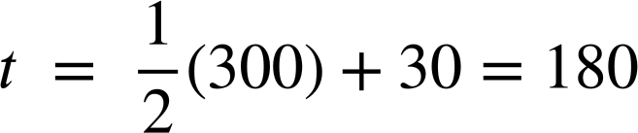
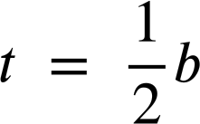
Emergency response worker
Task A: Uses of formulas
1) a) A firefighter enters the building with their gauge reading like so. At what bar should they turn around and start exiting?
They should turn around at 210 bar
b) A firefighter has an estimated turn-around pressure of 160 bar. How many bar of pressure did they have when they entered?
260 = b
They entered with 260 bar of pressure.
c) What is the difference in turn-around pressures between entering with 240 bar and entering with 300 bar?
240 bar of pressure:
300 bar of pressure:
180 − 150 = 30
The difference in turn-around is 30 bar of pressure.
d) Why do you think the formula includes + 30 instead of just being ?
You might have said, “If the formula were firefighters would turn around after using exactly half their air.
If they exerted more effort exiting (e.g. if they were carrying someone) they would not have sufficient air to get out safely.
Having +30 in the formula gives them a small safety buffer”.

Slide 2


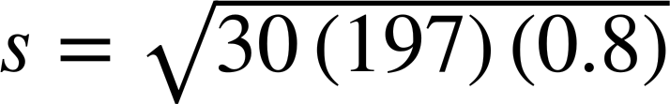
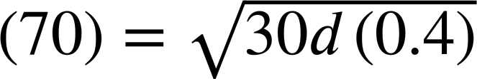


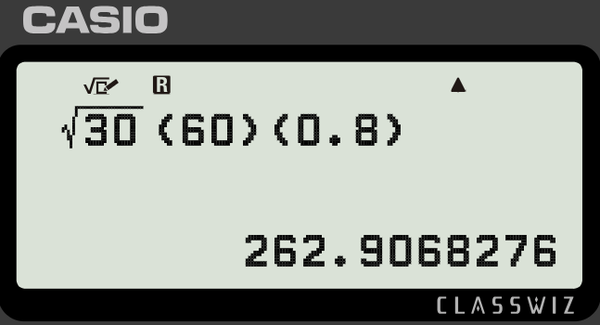

Emergency response worker
2) a) You are a police officer investigating an accident. Use the formula to calculate the speed of this car on a dry concrete surface (f = 0.8)
d = 197
197 feet
f = 0.8
s = 68.8 mph (to 1 d.p.)
b) If a car were travelling 70 mph on a wet concrete surface (f = 0.4) how long would you expect the skid mark to be?
4900 = 12d
d = 408.3 feet (to 1 d.p.)
c) Lucas has used the formula incorrectly to calculate the speed of a car with a skid mark of 60 feet on a dry concrete surface (f = 0.8). Explain his error to him and correct his work.
My calculator tells me their speed was 262.9 mph
You might have said:
“The vinculum should group the 30df ”
“The car was travelling 37.9 mph”
d) A police officer investigating an accident in a 20 mph zone with a dry concrete surface (f = 0.8) declares, “The length of the marks were 20 feet to the nearest 10 feet”.
Explain why they cannot round like this when investigating this accident.
You might have said: “By rounding to the nearest 10 the actual length falls in the bounds 15 ≤ d < 25 which makes the bounds for the speed…”
19.0 ≤ s < 24.5
“We cannot prove whether this driver was obeying the speed limit or not.”
‹#›

Slide 3
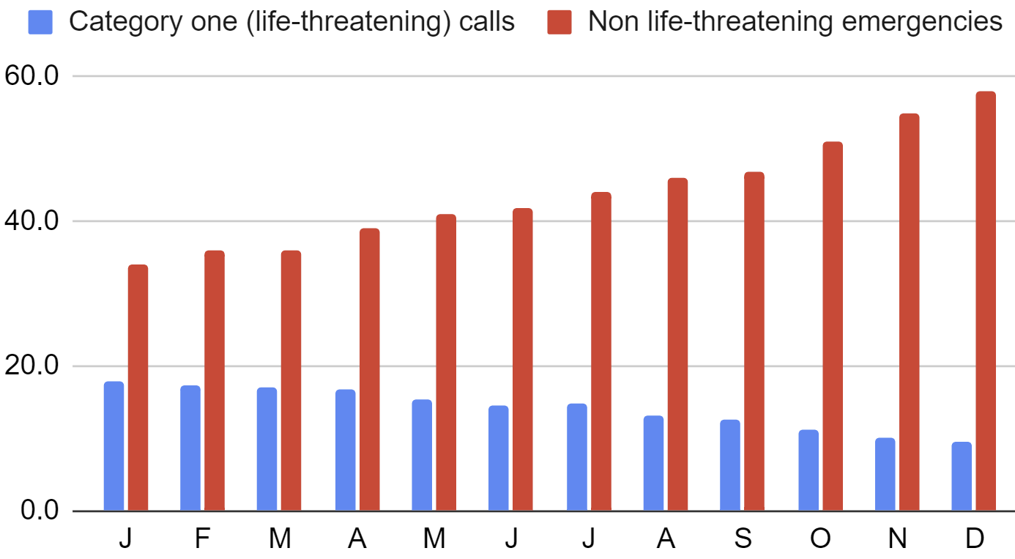
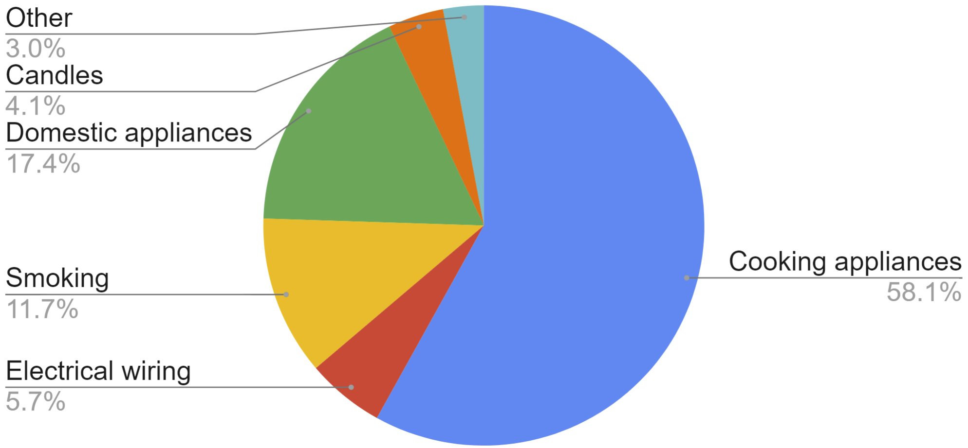
Emergency response worker
Task B: Uses of data
1) An ambulance station records their average response times to emergency calls one year. What patterns do you see in this data?
You might have said, “Response times to life-threatening calls are improving whereas non life-threatening response times are getting worse.”
2) A regional fire service records the reasons for house fires over a year and produces this chart. What advice would you give this fire service? Write at least three sentences.
You might have said:
The fire engines need to be adequately stocked with the correct gear to tackle cooking appliance fires as these account for more than half of the house fires.
Appliances (cooking and domestic) account for around three quarters of fires. This fire service might consider extra training for firefighters on these types of fires. Additionally they might consider a public campaign to help raise awareness of what causes these types of fires and what can be done to prevent them.
Mathematics in Education and Industry
v2.4

